Slide 1
EENG 385 PID Controller
Notes:
Usually the <title of the lab> is what will be called the “System” through the rest of this document

Slide 2
Lab Objectives
The objective of this lab is to understand how opamp building blocks can be combined to realize coimplex functionality and to provide students will a “feel” of how to tune a PID control.

Slide 3
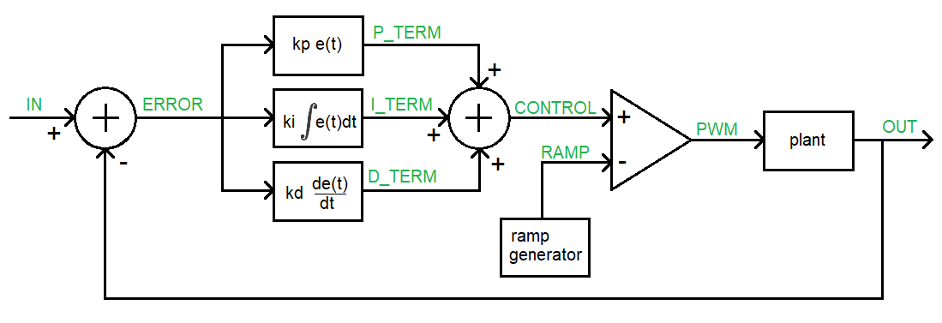
PID Controller
We want the plant output to track the input.
Proportional term - output is error time P gain
Integral – output is the integral of the error times I gain
Derritive – output is the derritive of the error times D gain
Notes:
Replace <System> with the name of the

Slide 4
Circuit Analysis
Using schematic
Find opamp that forms error
Find opamps that form proportional, integral and derivative
Determine how PWM signal is formed
Notes:
Replace <System> with the name of the

Slide 5
Tune the Controller
There are four different PID controller boards
Bessel, Butterword, 1dB Chebyshev, 3dB Chebyshev Different colors
Power input
If in doubt get one of us to check
4Hz square wave as input
Adjust PID until output is “closest” to output
Plot P, I and D terms by hand for square wave
Plot P, I and D terms by hand for triangle wave

Slide 6
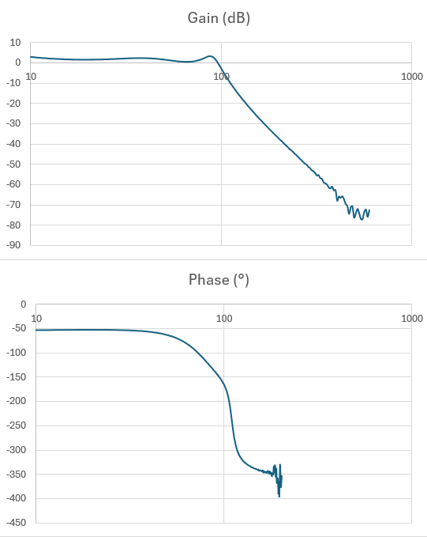
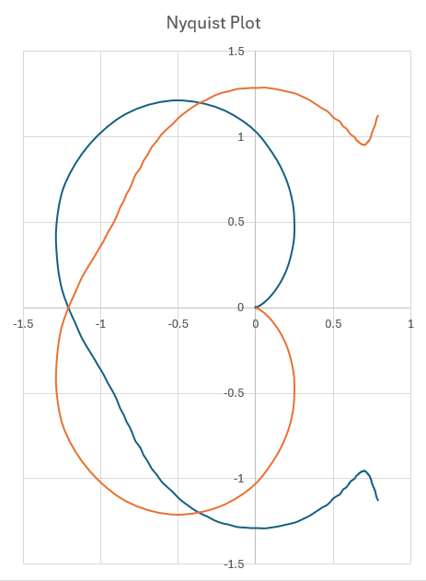
Optional
Use FRA on oscilloscope
Get Bode plot data
Export to Excel
Plot Bode plot
Plot Nyquist plot
Calculate gain margin
Put plant into unity gain feedback loop and verify stability/unstable.

Slide 7
Turn in
Circuit Operation
Steps 1-7
Tune the PID Controller
For the square wave input
An oscilloscope screenshot of the input and output
The approximate values of Kp, Ki and Kd
For the triangle wave input
An oscilloscope screenshot of the input and output
The approximate values of Kp, Ki and Kd

